Slide 1
Object Detection and Semantic Segmentation

Slide 2
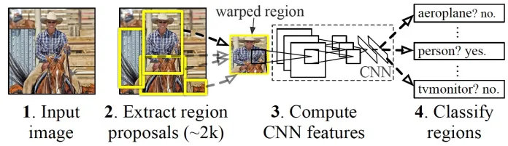
Sample workflow

Slide 3
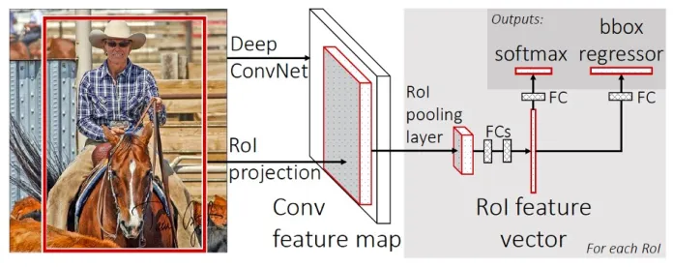
Internals 1

Slide 4
Internals 2
Module 1: Region Proposal. Generate and extract category independent region proposals, e.g. candidate bounding boxes.
Module 2: Feature Extractor. Extract feature from each candidate region, e.g. using a deep convolutional neural network.
Module 3: Classifier. Classify features as one of the known class, e.g. linear SVM classifier model. It can also be a NN. It only tells what’s present in the image.
Module 4: BBox generator: Output: x,y (min, max) to tell the BBox coords. It tells the location of the object in the image.
** A computer vision technique is used to propose candidate regions or bounding boxes of potential objects in the image called “selective search,” although the flexibility of the design allows other region proposal algorithms to be used.

Slide 5
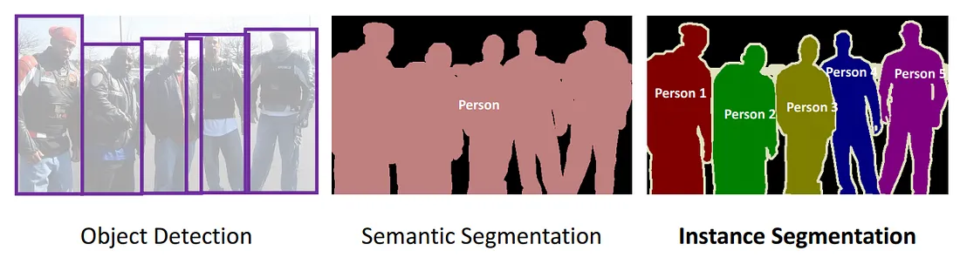
Semantic Segmentation
The goal of semantic image segmentation is to label each pixel of an image with a corresponding class of what is being represented. Because we’re predicting for every pixel in the image, this task is commonly referred to as dense prediction.

Slide 6
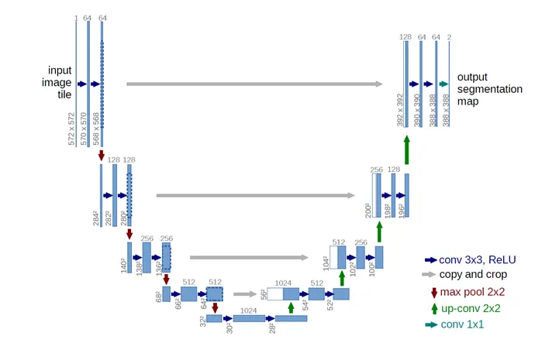
UNet

Slide 7
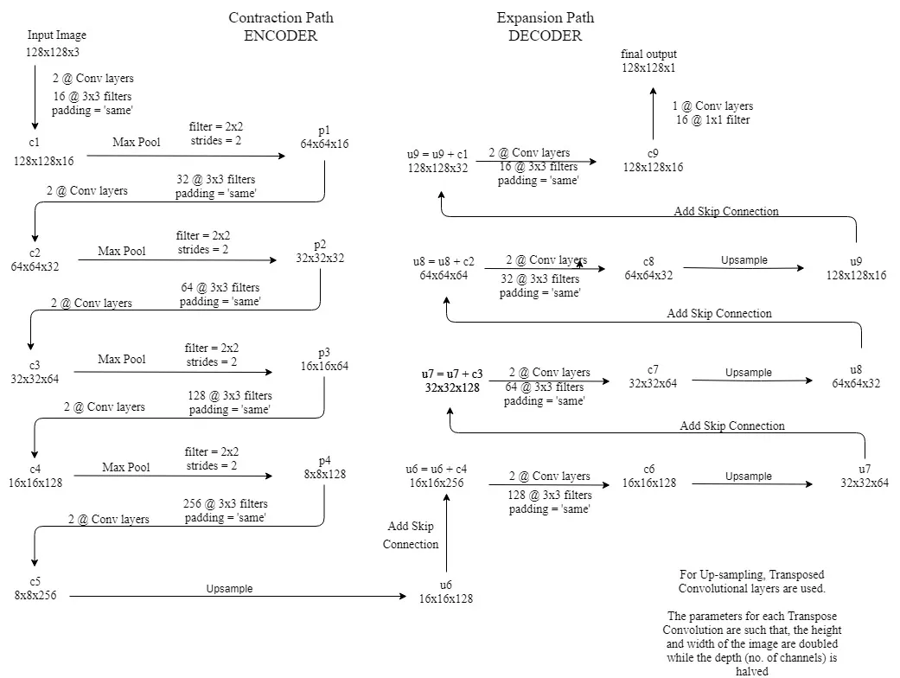

Slide 8
Points to note
2@Conv layers means that two consecutive Convolution Layers are applied
c1, c2, …. c9 are the output tensors of Convolutional Layers
p1, p2, p3 and p4 are the output tensors of Max Pooling Layers
u6, u7, u8 and u9 are the output tensors of up-sampling (transposed convolutional) layers
The left hand side is the contraction path (Encoder) where we apply regular convolutions and max pooling layers.
In the Encoder, the size of the image gradually reduces while the depth gradually increases. Starting from 128x128x3 to 8x8x256
This basically means the network learns the “WHAT” information in the image, however it has lost the “WHERE” information
The right hand side is the expansion path (Decoder) where we apply transposed convolutions along with regular convolutions
In the decoder, the size of the image gradually increases and the depth gradually decreases. Starting from 8x8x256 to 128x128x1
Intuitively, the Decoder recovers the “WHERE” information (precise localization) by gradually applying up-sampling
To get better precise locations, at every step of the decoder we use skip connections by concatenating the output of the transposed convolution layers with the feature maps from the Encoder at the same level:
u6 = u6 + c4
u7 = u7 + c3
u8 = u8 + c2
u9 = u9 + c1
After every concatenation we again apply two consecutive regular convolutions so that the model can learn to assemble a more precise output
This is what gives the architecture a symmetric U-shape, hence the name UNET
On a high level, we have the following relationship:
Input (128x128x1) => Encoder =>(8x8x256) => Decoder =>Output (128x128x1)

